Slide 1
Intelligent Solution
Prepared by :-
1-Mohammed Ali Gammer Al-anbia
2-Abubakr Almusalmi Saeed
3-Ahmed Hussein Abker

Slide 2
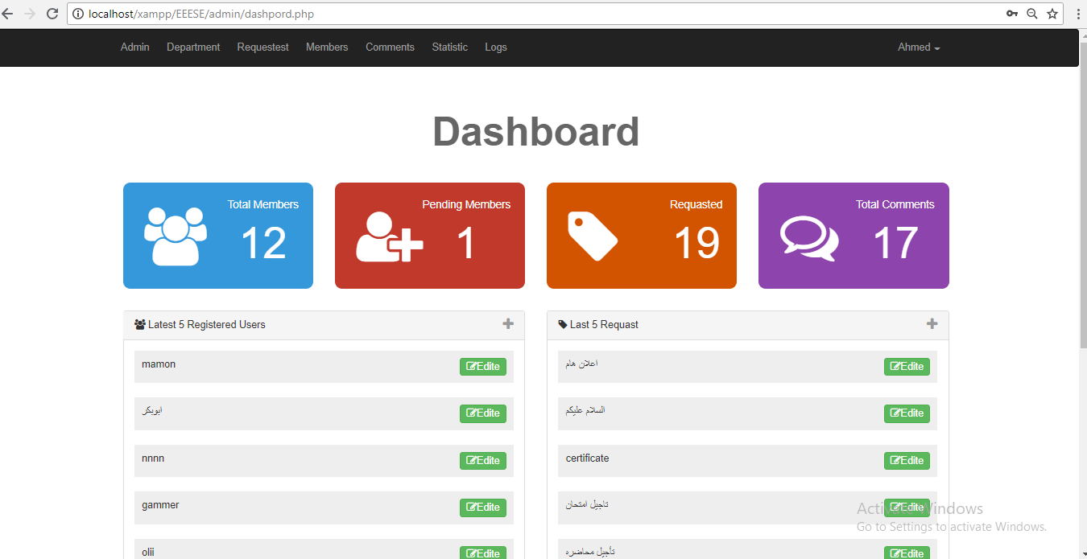
Admin Dashboard

Slide 3
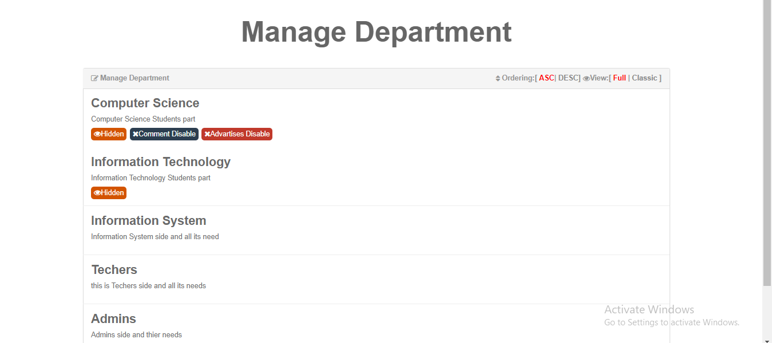
Departments Management

Slide 4
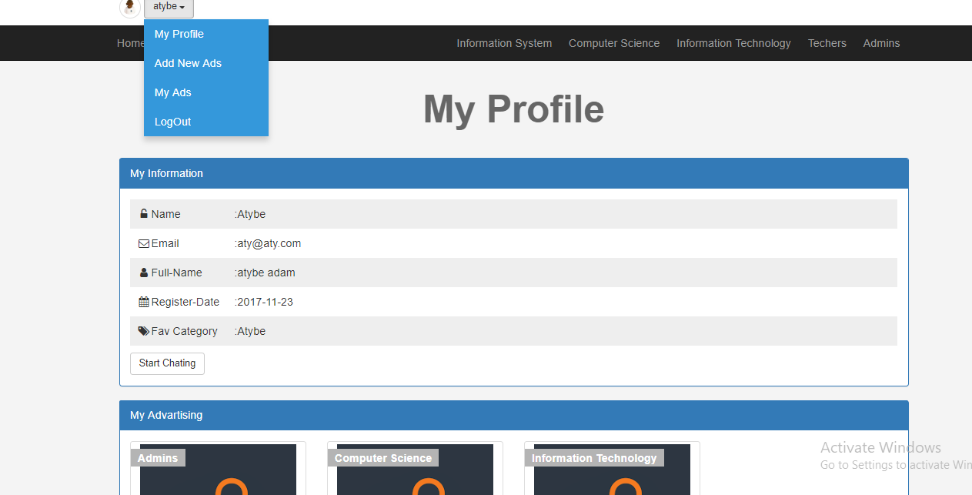
User Profile

Slide 5
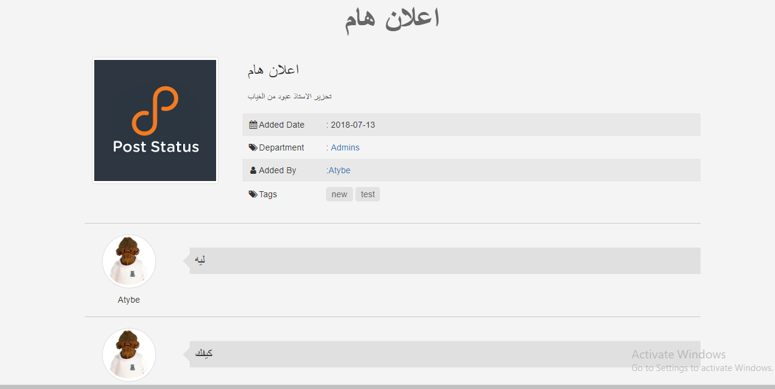
Postes

Slide 6
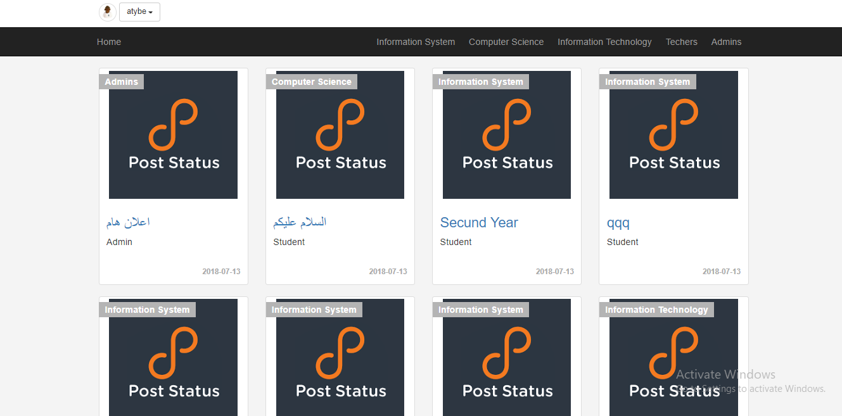
Sheered Posted

